Slide 1
Smart security for crop cultivation
Guide: Done by:
K. Raghavendra Rao A. Sumanth Kumar
S. Akhil Reddy
MD. Arshiya

Slide 2
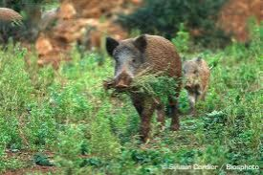
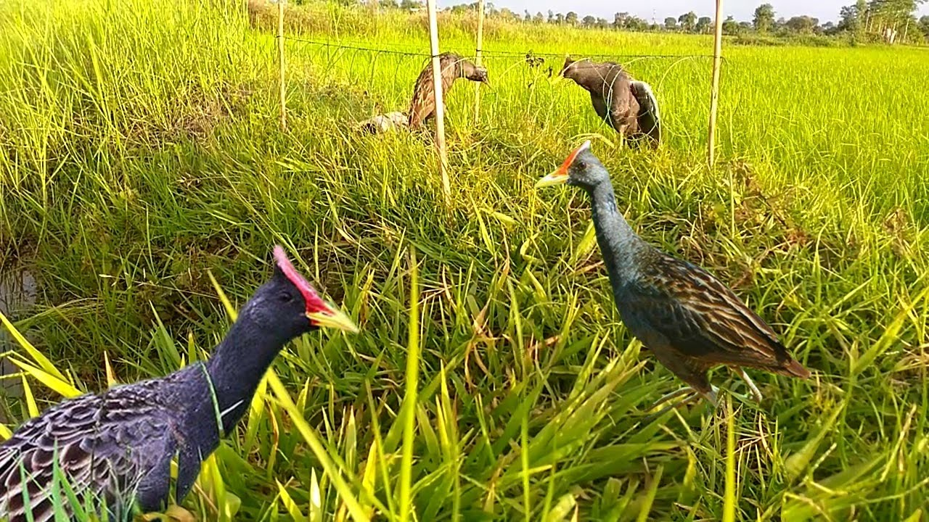
Problem Statement
Animal attack
Bird attack

Slide 3
Statistics and Social issue
96% of farmers agreed that damage was caused by wild animals to crop fields
The total value of livestock losses at prevailing market rates is about Rs. 1024520 (US$ 29272) in the study villages.
annual production of crops reduces causing economic losses to farmers. farmer suicide is big problem due to low productivity among farms.

Slide 4
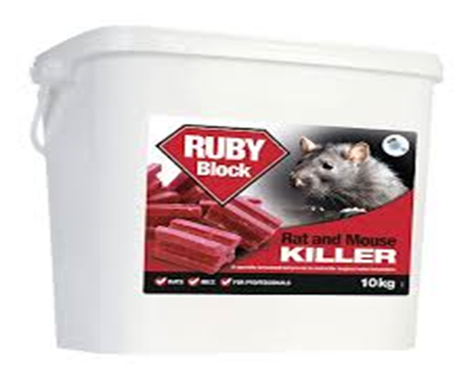
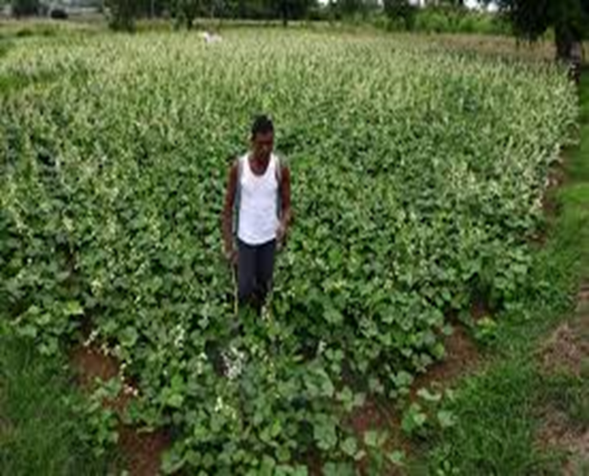
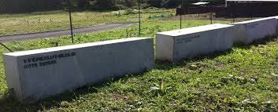
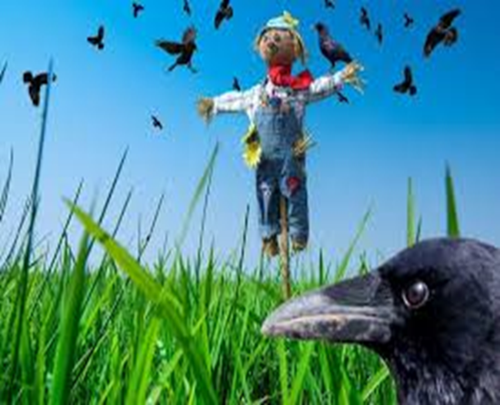
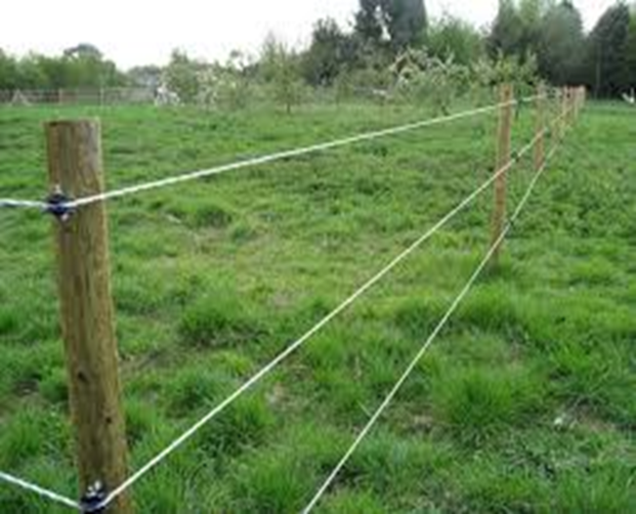
Existing Solutions
Physical Barriers
Human puppets
Human Surveillance
Electric fences
Use of Poison Bait

Slide 5
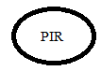


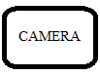




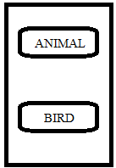
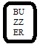
Proposed Solution
PIR sensor for detecting a living object
Raspberry pi to take photo snap and upload it to cloud
Ultrasonic rappeler
Buzzer for making a buzz

Slide 6
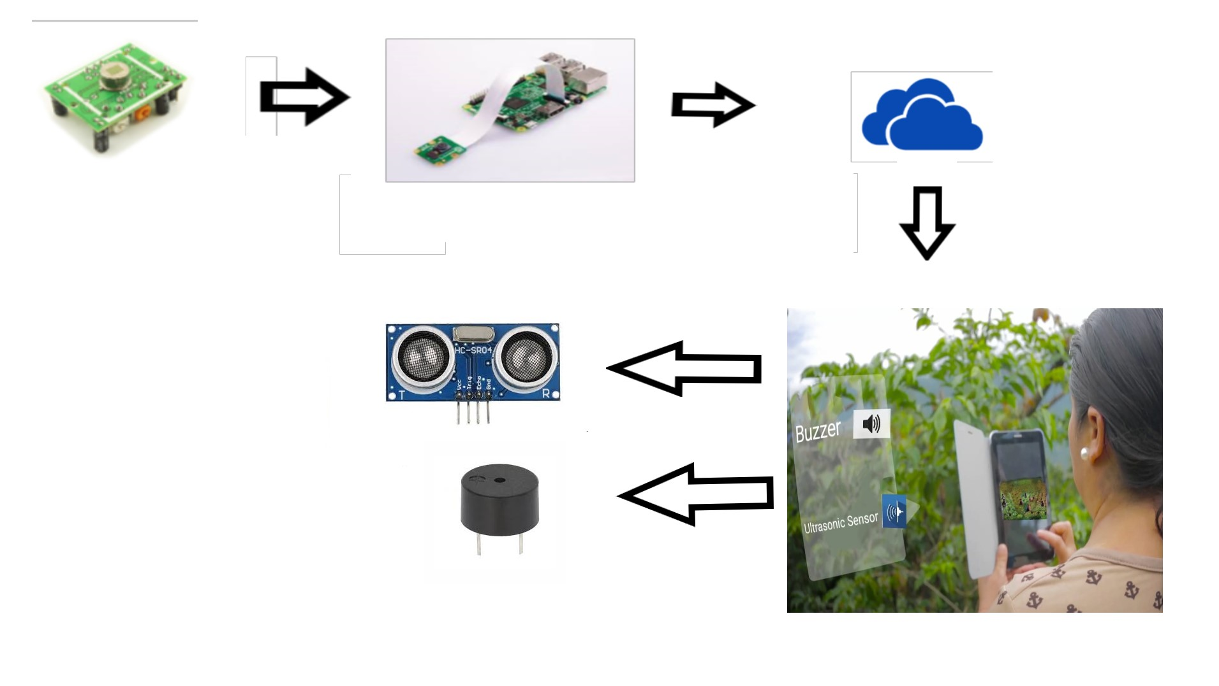
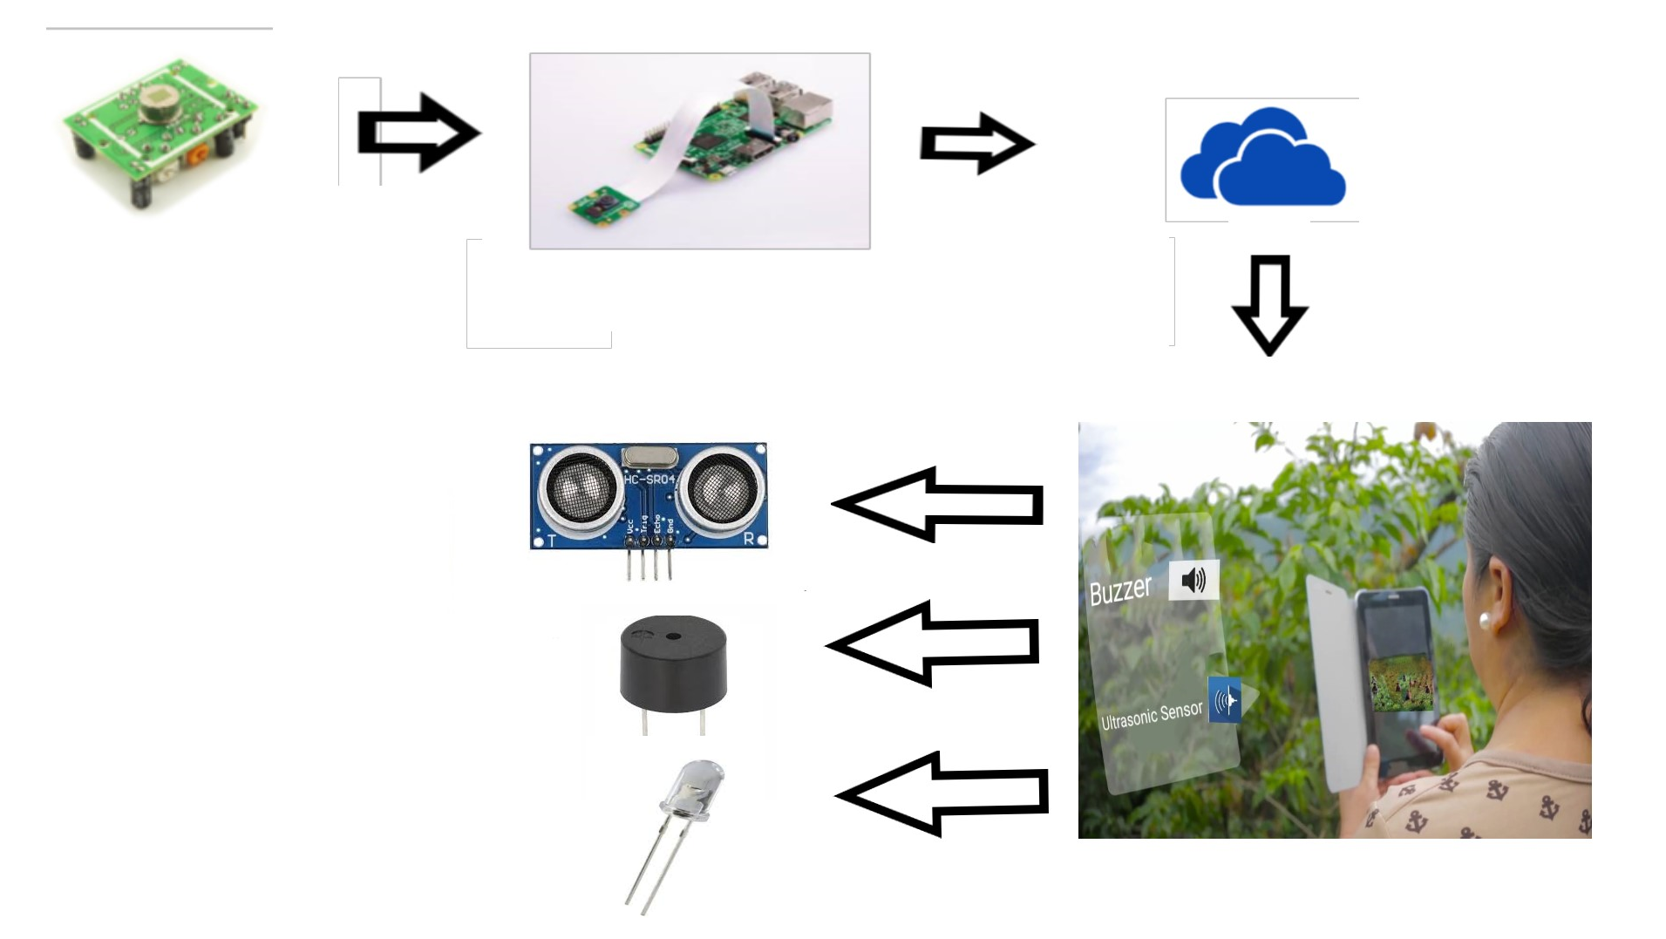
Proposed Solution

Slide 7
Technology and Components
Technology
IOT
Python
Raspbian OS
Android
Cloud
Components
PIR Sensor
Raspberry pi and Camera
Ultrasonic Sensor
Buzzer
Bulb

Slide 8
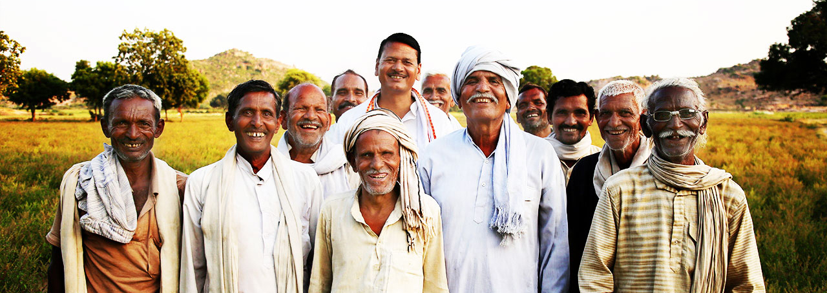
Target Customers

Slide 9
Thank you

